Slide 1
CUSTOMER BOOKINGS PREDICTIONS
SOLOMON FAITH O.

Slide 2
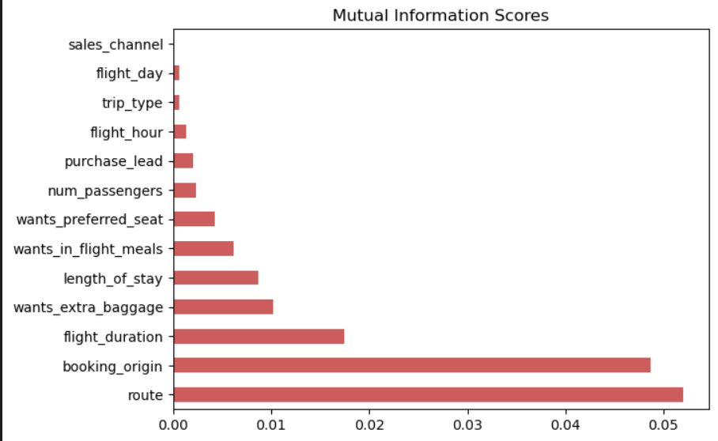
85%
The relevant features used in training the model are:
Route
Booking_origin
Flight_duration
Wants_extra_baggage
Length of stay
Using XGBoostClassifier from XGBoost, which is known for it’s high accuracy and scalability, we achieved 85.29% accuracy and roc_auc_score of 0.523.
Using mutual information scores, I was able to determine the relevant fields or features that influence a customer’s purchase of a trip with us.

